Slide 1
Math Homework 1
Jim Mundy
December 30, 2018

Slide 2
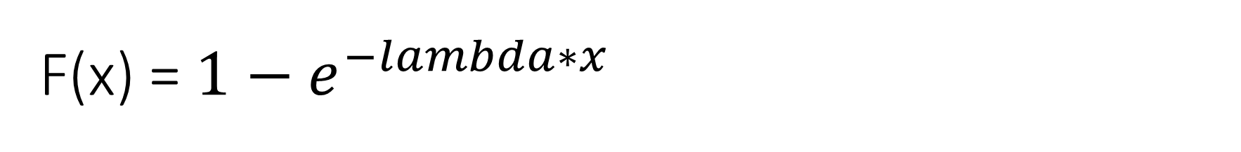
F(x) = $1−e^{−lambda∗x}$
Answer: -lambda*e^(lambda * x)
= d/dx 1 – d/dx [e^(lambda * x)]
= 0 -e^(lambda * x) d/dx [lambda* x]
= -lambda d/dx[x] * e^(lambda*x)
= -1* lambda * e ^(lambda *x)
=-lambda*e^(lambda * x)

Slide 3
F(x) = (x-a) / (b-a)
Answer: 1 / (b-a)
Work:
= 1 / (b-a) * (d/dx[X] + d/dx[-a])
= 1 + 0 / (b-a)
= 1 / (b-a)

Slide 4
F(x) = (x-a)^2 / (b-a)*(c-a)
Answer: 2*(x-a) /((b-a)*(c-a))
=1*(b−a)*(c−a)* ddx [(x−a)2]
=2*(x−a)* d/dx[x−a](b−a)(c−a)
=2*(d/dx [x] + d/dx[−a])*(x−a)/((b−a)(c−a))
=2*(1+0)(x−a) / ((b−a)(c−a))
=2*(x−a) / ((b−a)*(c−a))

Slide 5
F(x) = 1 –[ (b-x)^2 / (b-a)*(c-a)]
Answer: 2*(b-x) / [(b-a)*(c-a)]
= -1 / ((b-a)*(c-a)) d/dx *[(b-x)^2]+d/dx*1
= 0 – 2(b-x)*d/dx[b-x] / ((b-a) * (c-a))
= -(2(d/dx[b] – d/dx[x])*(b-x)) / ((b-a) * (c-a))
= -2*(0-1)(b-x) / ((b-a)(c-a))
= 2*(b-x) / [(b-a)*(c-a)]

Slide 6


$$\int_{0}^{10}{3X^{3}dx}$$
Answer = 3x^4 / 4 + C = 7500
Work:
= 3 $∫$ x^3 dx
$= ∫$X^3dx = x^(n+1) / (n+1) = x ^4 / 4
= 3X^4 / 4
= 3X^4 / 4 +C = 7500

Slide 7

$$\int_{0}^{x}{Xλe^{−λx}dx}$$

Slide 8


$$\int_{0}^{.5}{1/\left(b−a\right)dx}$$
Answer= 0.5 / (b-a)
= 1/(b-a) $∫$ 1 dx
= 1/(b-a) $∫$ x
= x / (b-a)
= 0.5 / (b-a)

Slide 9

$$\int_{0}^{x}{X∗\left(\frac{1}{Γ\left(α\right)β^{α}}\right)∗X^{{{}^{}}^{α−1}}e^βx}dx$$

Slide 10
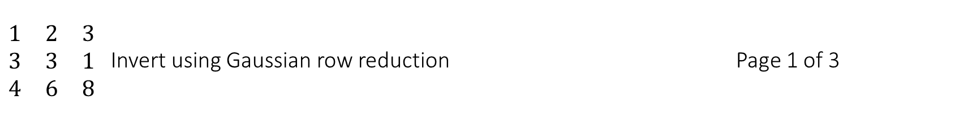
$\begin{matrix}1 & 2 & 3 \\ 3 & 3 & 1 \\ 4 & 6 & 8\end{matrix}$ Invert using Gaussian row reduction Page 1 of 3
1,2,2|1,0,0
3,3,1|0,1,0
4,6,8|0,0,1
3,6,6|3,0,0
3,3,1|0,1,0 multiple r1 by 3
4,6,8|0,0,1
1,2,2|1,0,0
0,-3,-5|-3,1,0 Subtract r1 from r2, –restore 1
4,6,8|0,0,1
1,2,2|1,0,0
0,-3,-5|-3,1,0 multiple r1 by 4
4,6,8|0,0,1
1,2,2|1,0,0
0,-3,-5|-3,1,0 subtract r1 from r3 and restore
0,-2,0|-4,0,1

Slide 11
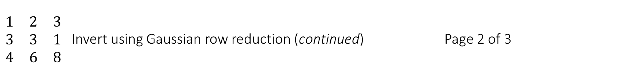
$\begin{matrix}1 & 2 & 3 \\ 3 & 3 & 1 \\ 4 & 6 & 8\end{matrix}$ Invert using Gaussian row reduction (continued) Page 2 of 3
1,2,2|1,0,0
0,-3,-5|-3,1,0 subtract r1 from r3 and restore
0,-2,0|-4,0,1
1,2,2|1,0,0
0,1,5/3|1,-1/3,0 divide r2 by -3
0,-2,0|-4,0,1
1,2,2|1,0,0
0,2,10/3|2,-2/3,0 multiply r2 by 2
0,-2,0|-4,0,1
1,0,-4/3|-1,2/3,0
0,2,10/3|2,-2/3,0 subtract r2 by r1
0,-2,0|-4,0,1
1,0,-4/3|-1,2/3,0
0,-2,-10/3|-2,2/3,0 multiply r2 by -1
0,-2,0|-4,0,1
1,0,-4/3|-1,2/3,0
0,1,5/3|1,-1/3,0 subtract r2 from r3 and restore r2
0,0,10/3|-2,-2/3,1

Slide 12
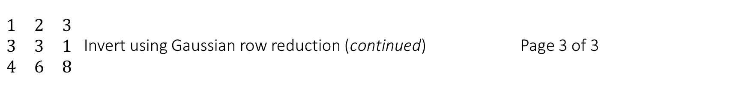
$\begin{matrix}1 & 2 & 3 \\ 3 & 3 & 1 \\ 4 & 6 & 8\end{matrix}$ Invert using Gaussian row reduction (continued) Page 3 of 3
1,0,-4/3|-1,2/3,0
0,1,5/3|1,-1/3,0 subtract r2 from r3 and restore r2
0,0,10/3|-2,-2/3,1
1,0,-4/3|-1,2/3,0
0,1,5/3|1,-1/3,0 divide r3 by 10/3
0,0,1|-3/5,-1/5,3/10
1,0,-4/3|-1,2/3,0
0,1,5/3|1,-1/3,0 multiply r3 by -4/3
0,0,-4/3|4/5,4/15,-2/5
1,0,0|-9/5,2/5,2/5
0,1,5/3|1,-1/3,0 subtract r3 from r1 , restore
0,0,1|-3/5,-1/5,3/10
1,0,0|-9/5,2/5,2/5
0,1,5/3|1,-1/3,0 multiply r3 by 5/3
0,0,5/3|-1,-1/3,1/2
1,0,0|-9/5,2/5,2/5
0,1,0|2,0,-1/2 subtract r3 frim r2, restore
0,0,1|-3/5,-1/5,3/10

Slide 13
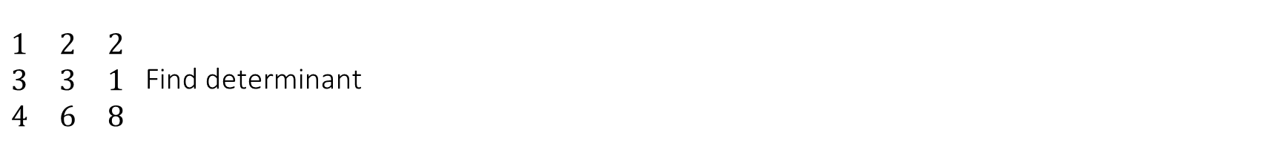
$\begin{matrix}1 & 2 & 2 \\ 3 & 3 & 1 \\ 4 & 6 & 8\end{matrix}$ Find determinant
Answer = -4
Work:
(1*3*8) + (2*1*1) + (3*3*6)-
(3*3*4) – (1*1*6) – (2*3*8) = -4

Slide 14
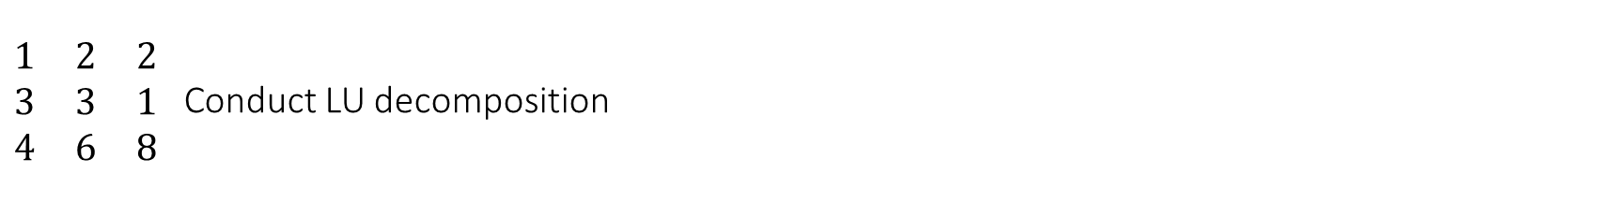
$\begin{matrix}1 & 2 & 2 \\ 3 & 3 & 1 \\ 4 & 6 & 8\end{matrix}$ Conduct LU decomposition

Slide 15
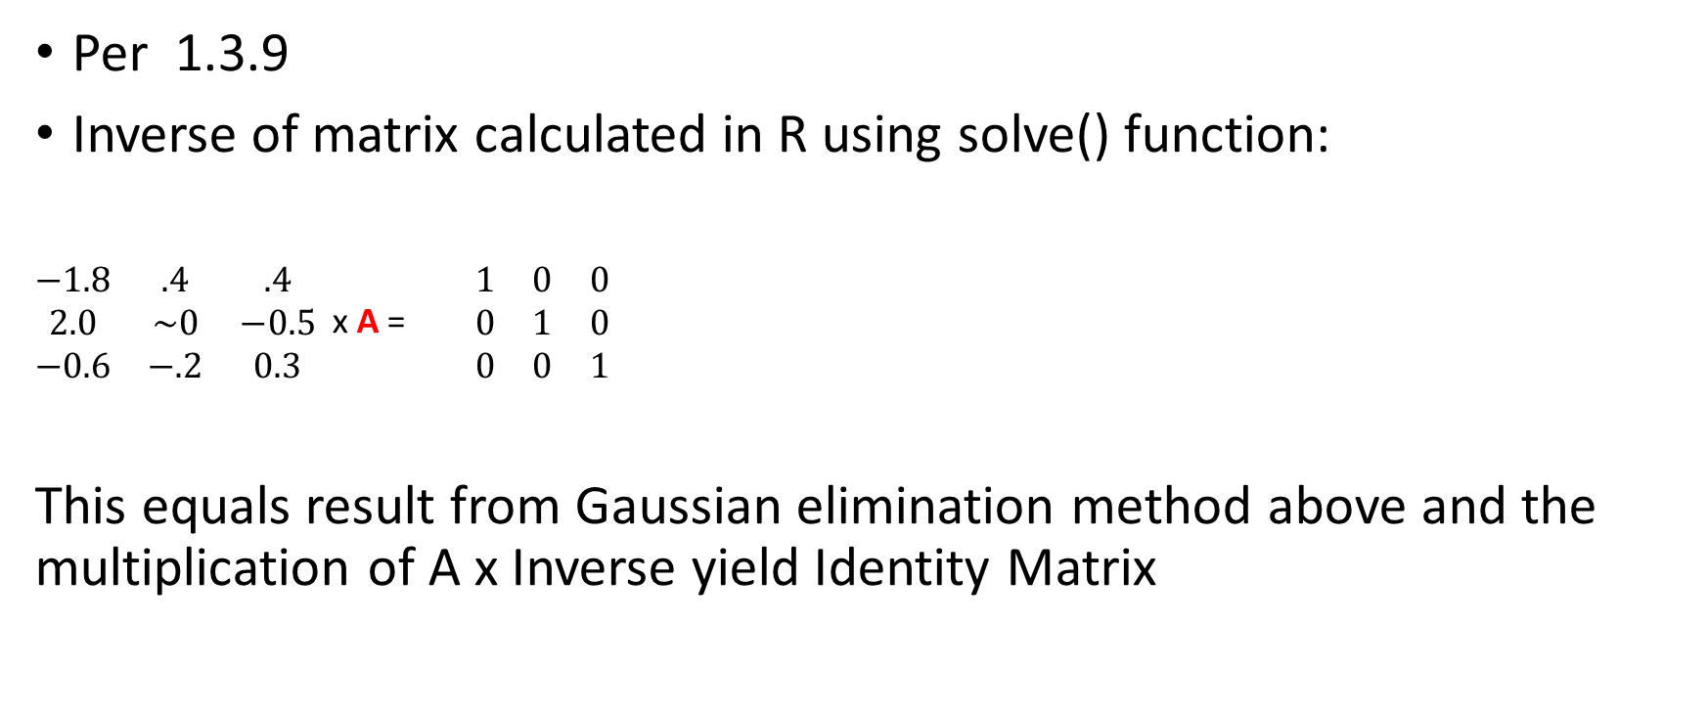
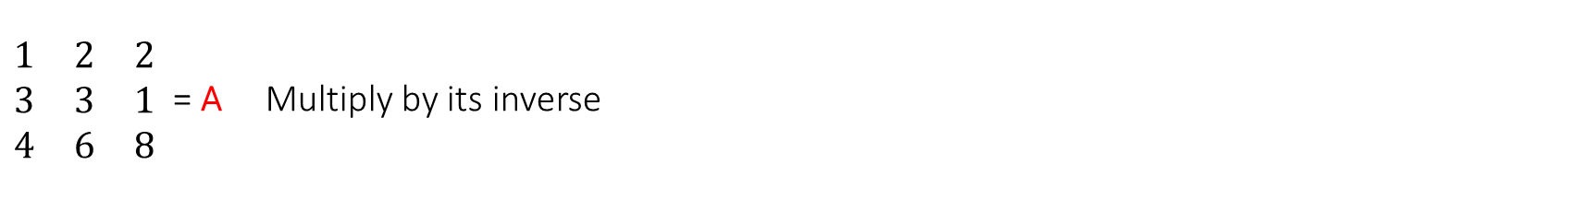
$\begin{matrix}1 & 2 & 2 \\ 3 & 3 & 1 \\ 4 & 6 & 8\end{matrix}$ = A Multiply by its inverse
Per 1.3.9
Inverse of matrix calculated in R using solve() function:
$\begin{matrix}−1.8 & .4 & .4 \\ 2.0 & \sim 0 & −0.5 \\ −0.6 & −.2 & 0.3\end{matrix}$ x A = $\begin{matrix}1 & 0 & 0 \\ 0 & 1 & 0 \\ 0 & 0 & 1\end{matrix}$
This equals result from Gaussian elimination method above and the multiplication of A x Inverse yield Identity Matrix

